Slide 1



PhD Viva
Rory Nolan

Slide 2
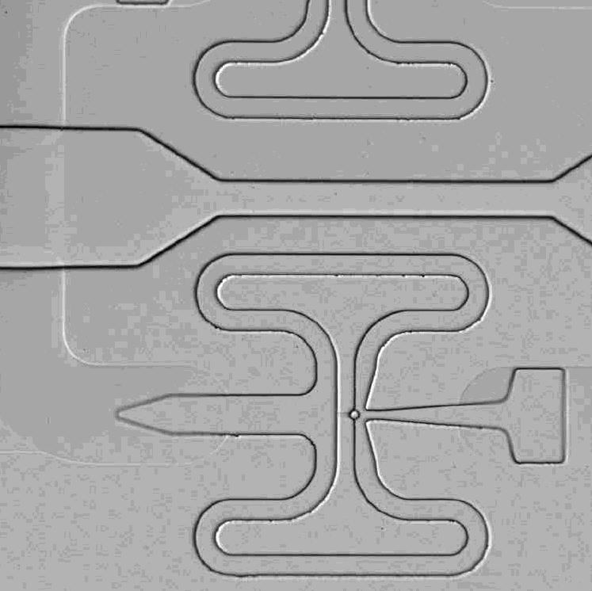
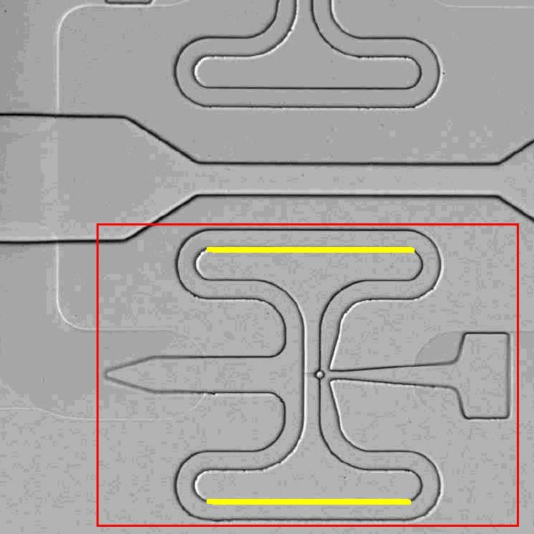
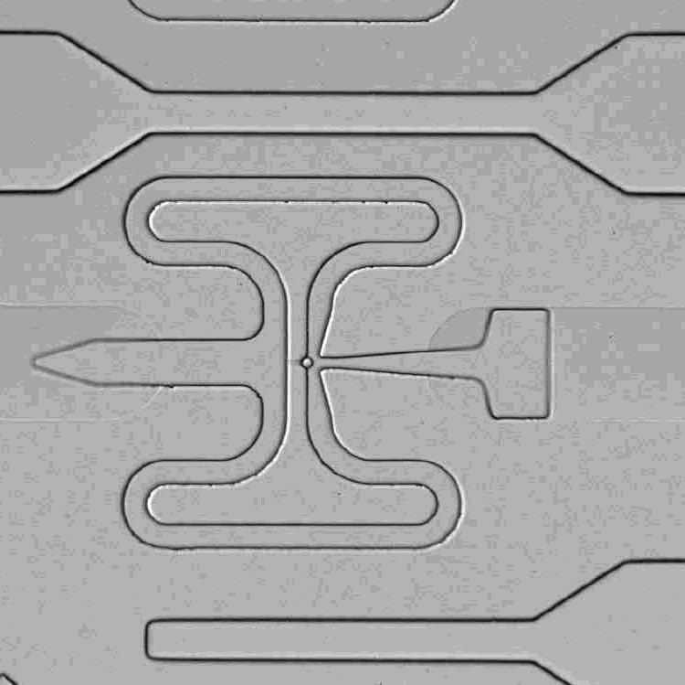
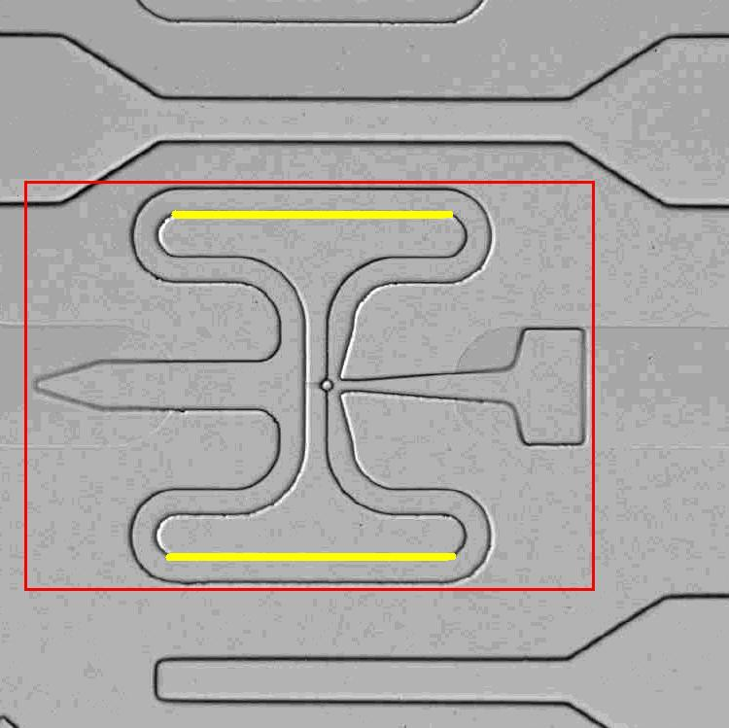
Single-cell capture

Slide 3
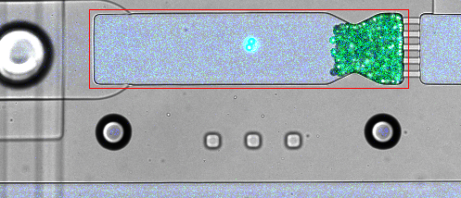
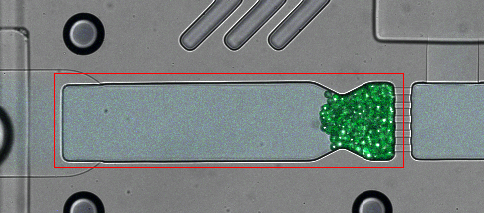
Single-cell capture
Wills et al. The nature and nurture of cell heterogeneity: accounting for macrophage gene-environment interactions with single-cell RNA-Seq.
BMC Genomics, 2016.

Slide 4
Cancer evolution modelling

Slide 5
HIV Entry Modelling
Plasma membrane fusion
Fusion via endocytosis

Slide 6
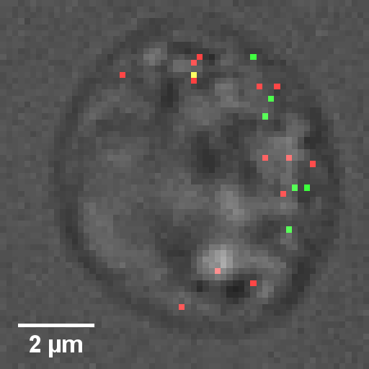
HIV Entry Modelling

Slide 7
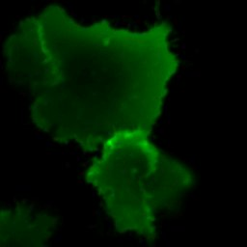
Number and Brightness
y
pixel1
x
t

Slide 8
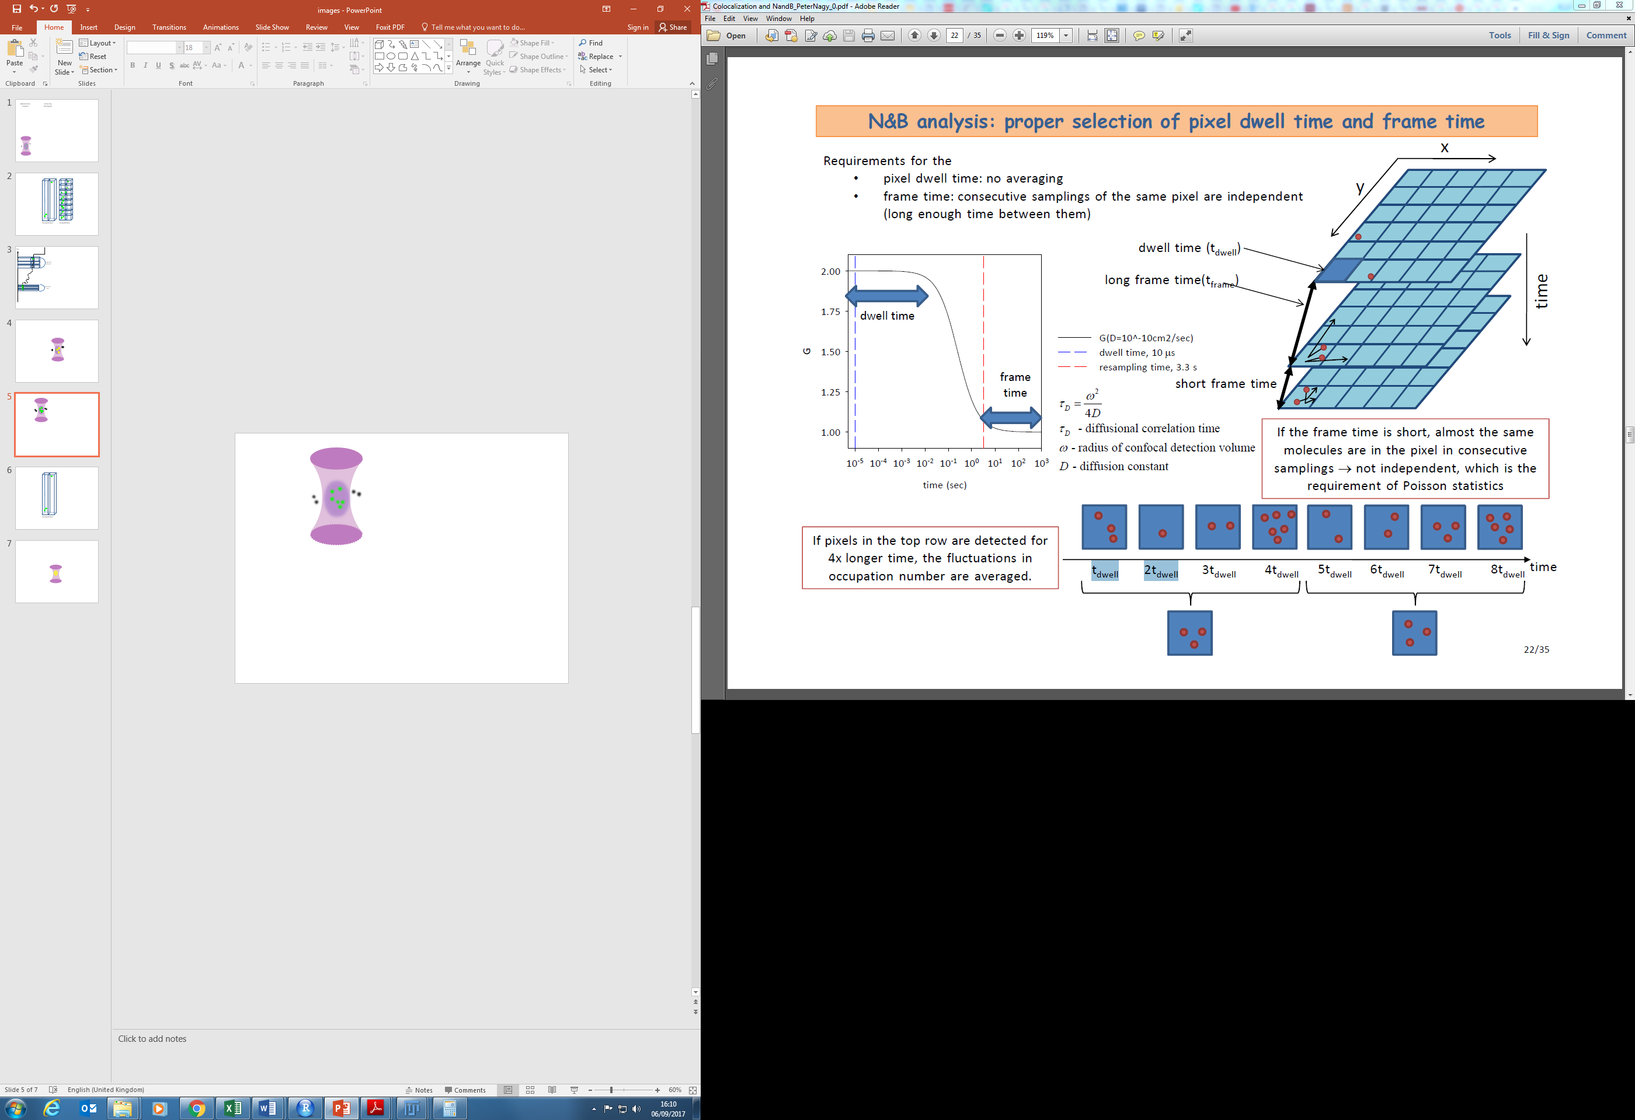
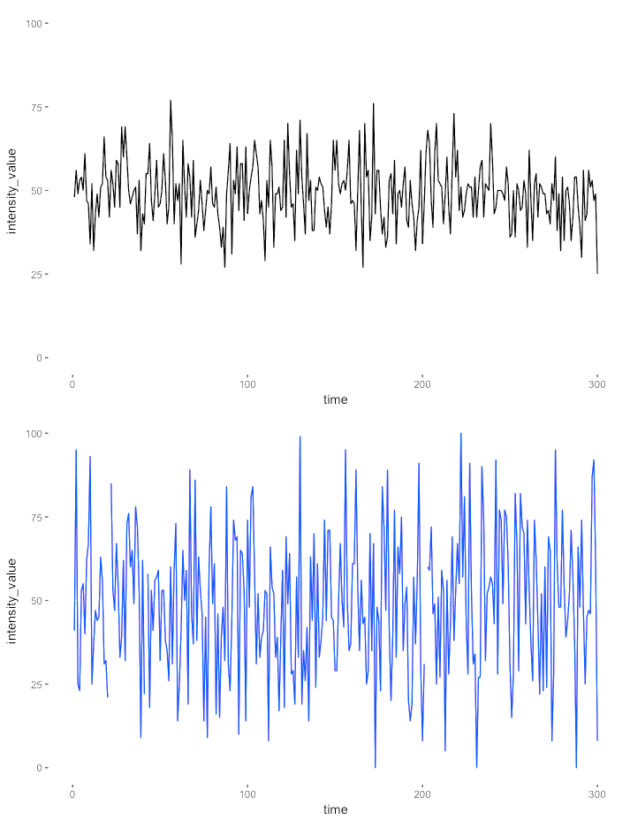
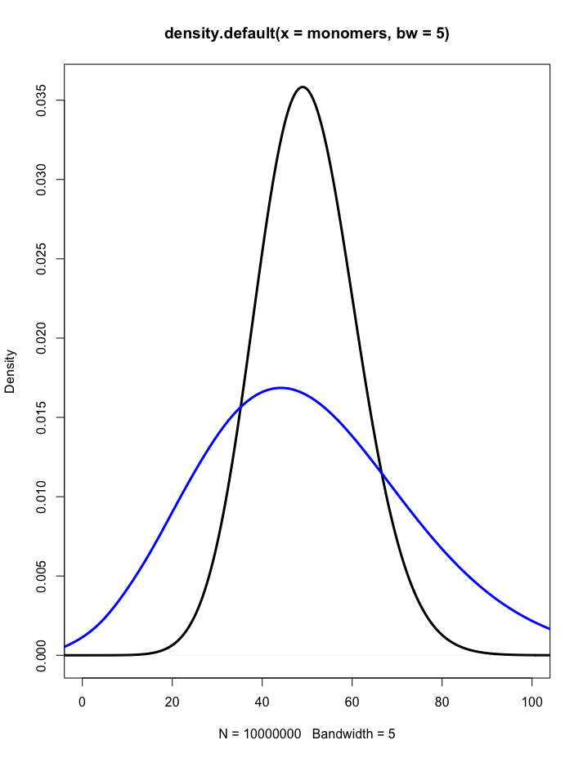
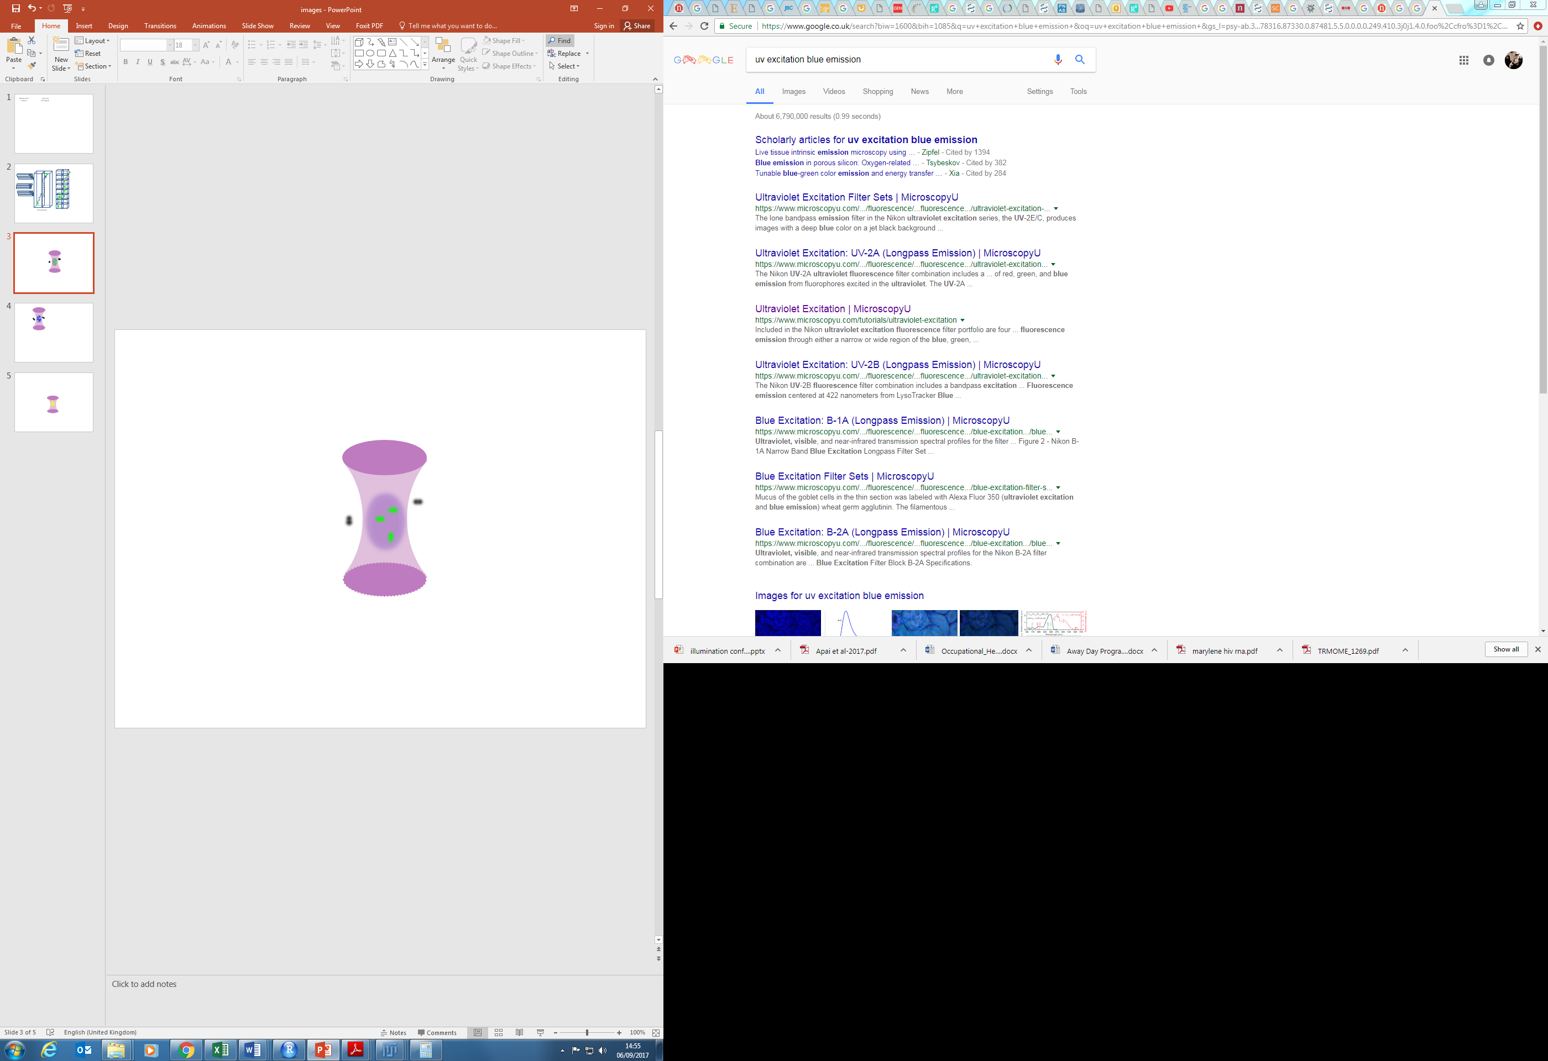
Number and Brightness
Confocal volume
Intensity traces
I
Intensity densities
I
t
I
t
t

Slide 9
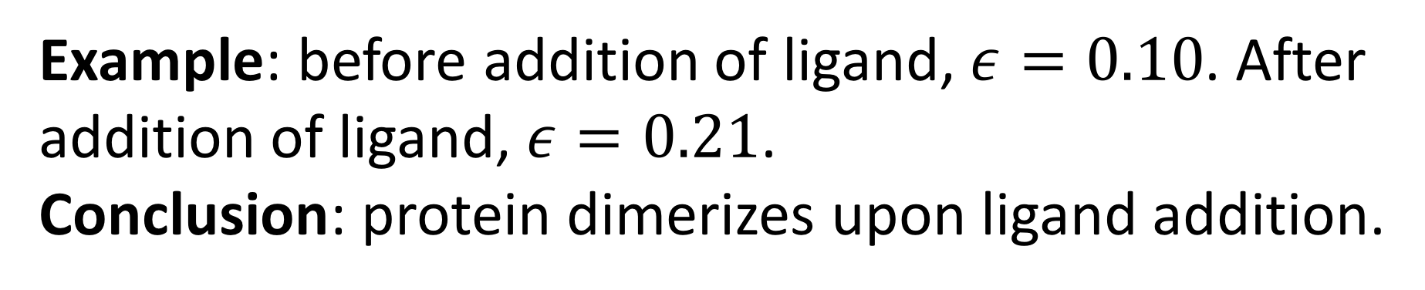


Number and Brightness
$$B=\frac{σ^{2}}{μ}$$
$$ε=\frac{σ^{2}}{μ}−1$$
Example: before addition of ligand, $ε=0.10$. After addition of ligand, $ε=0.21$.
Conclusion: protein dimerizes upon ligand addition.
t
Large particles

Slide 10
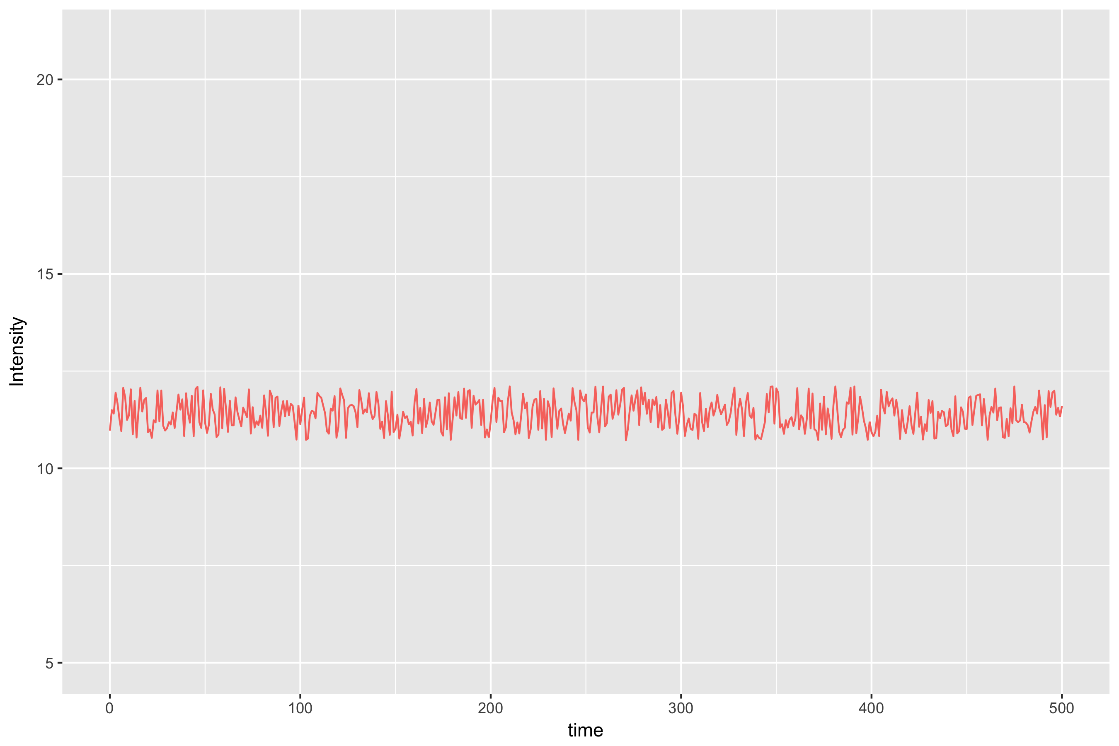
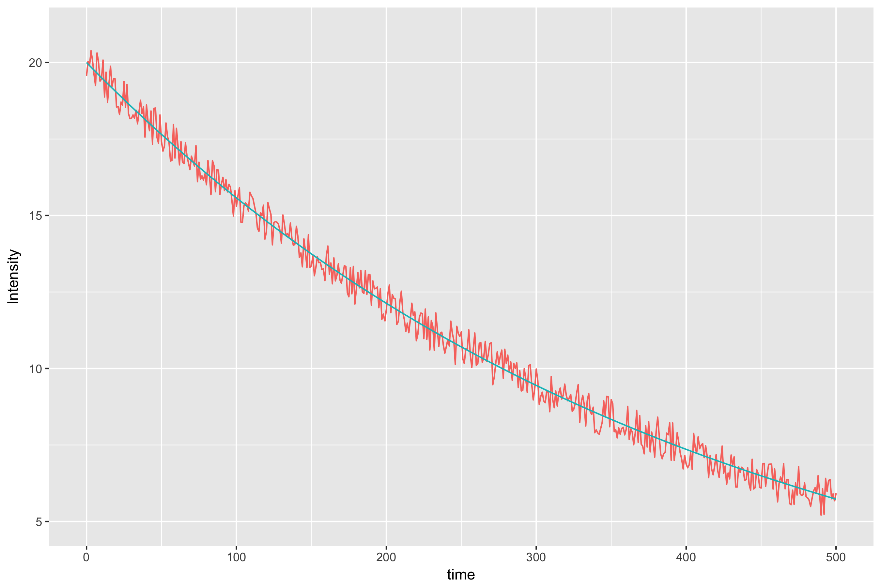
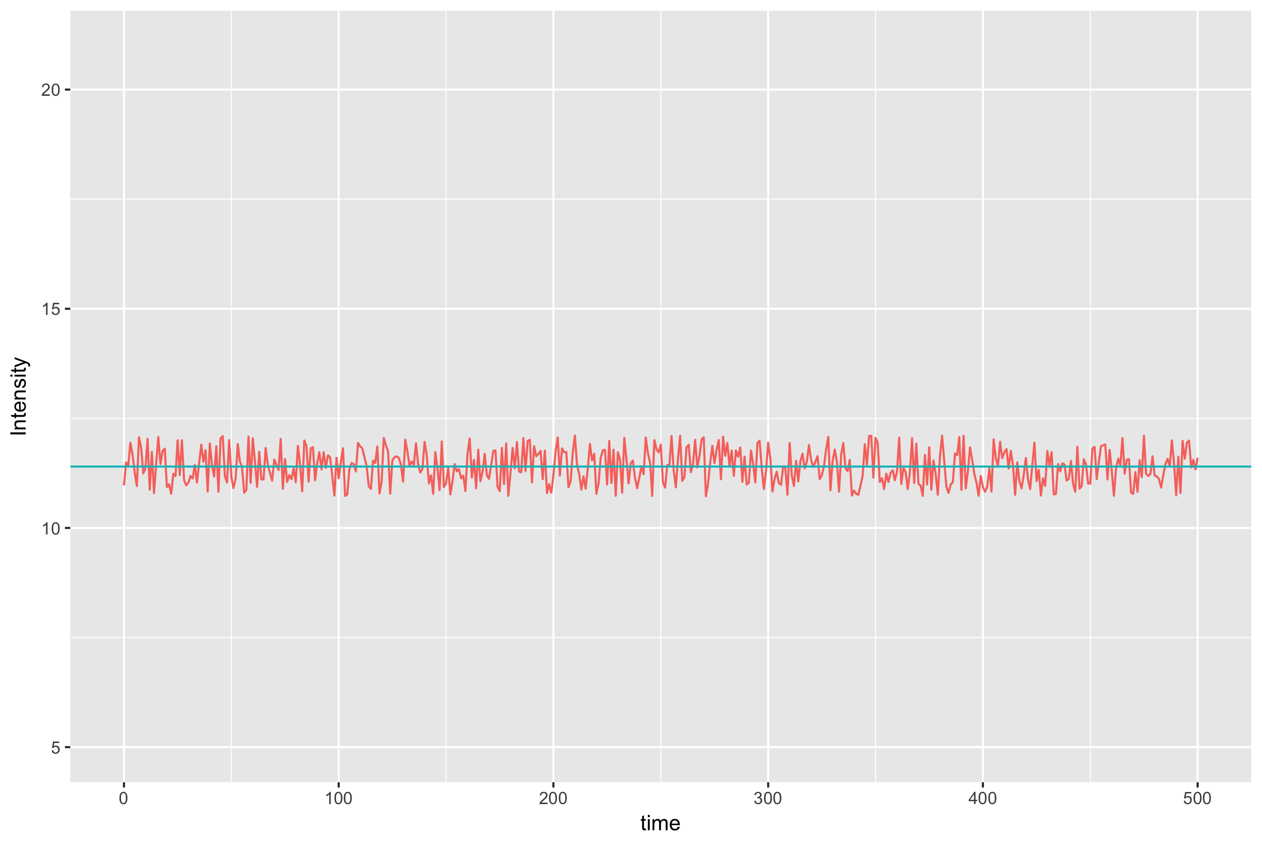

Bleaching
t

Slide 11
“Boxcar” smoothing
Boxcar of length 3
Notes:
So we want to correct this diminishing time series into one with a stationary mean. Insert a smooth line, recapitulate as ts with same deviations from line, but a different line, a straight line. The technique is very sensitive to the way in which you obtain this smooth line, so it's very important to do that well.

Slide 12
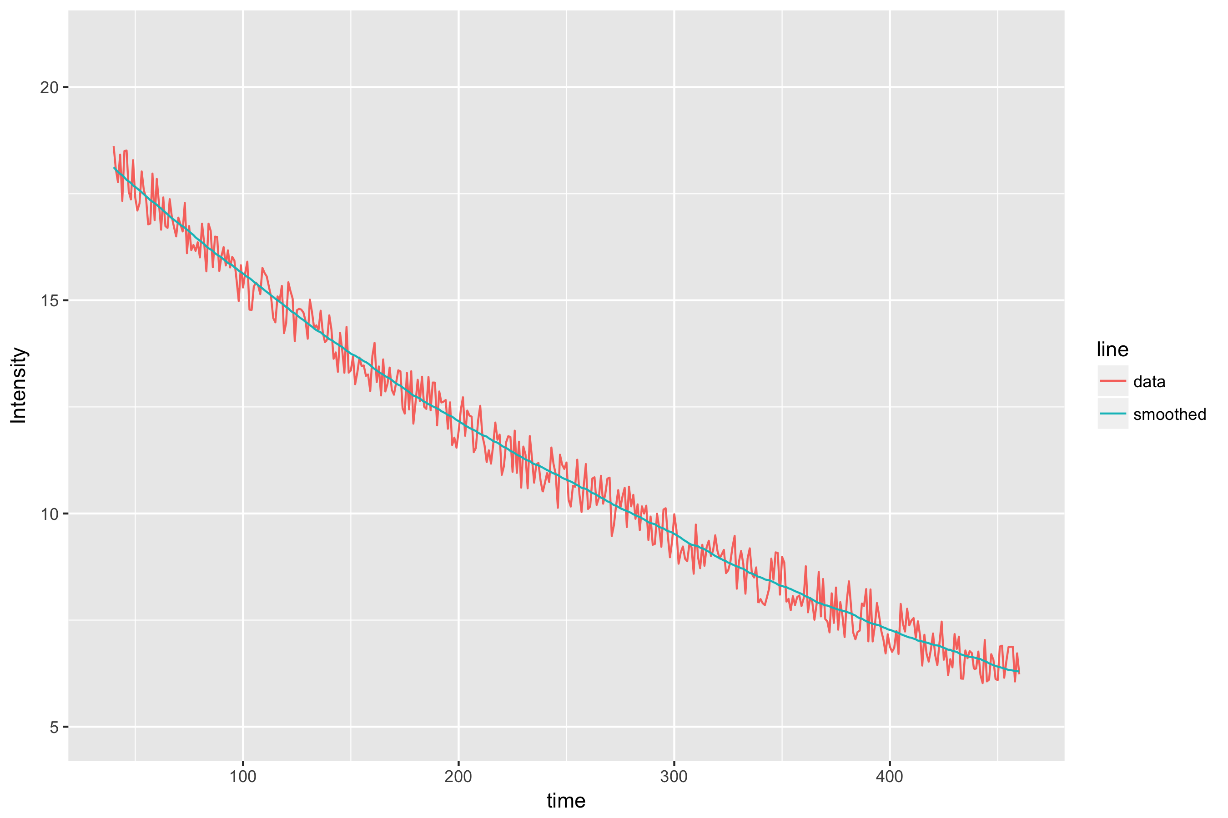
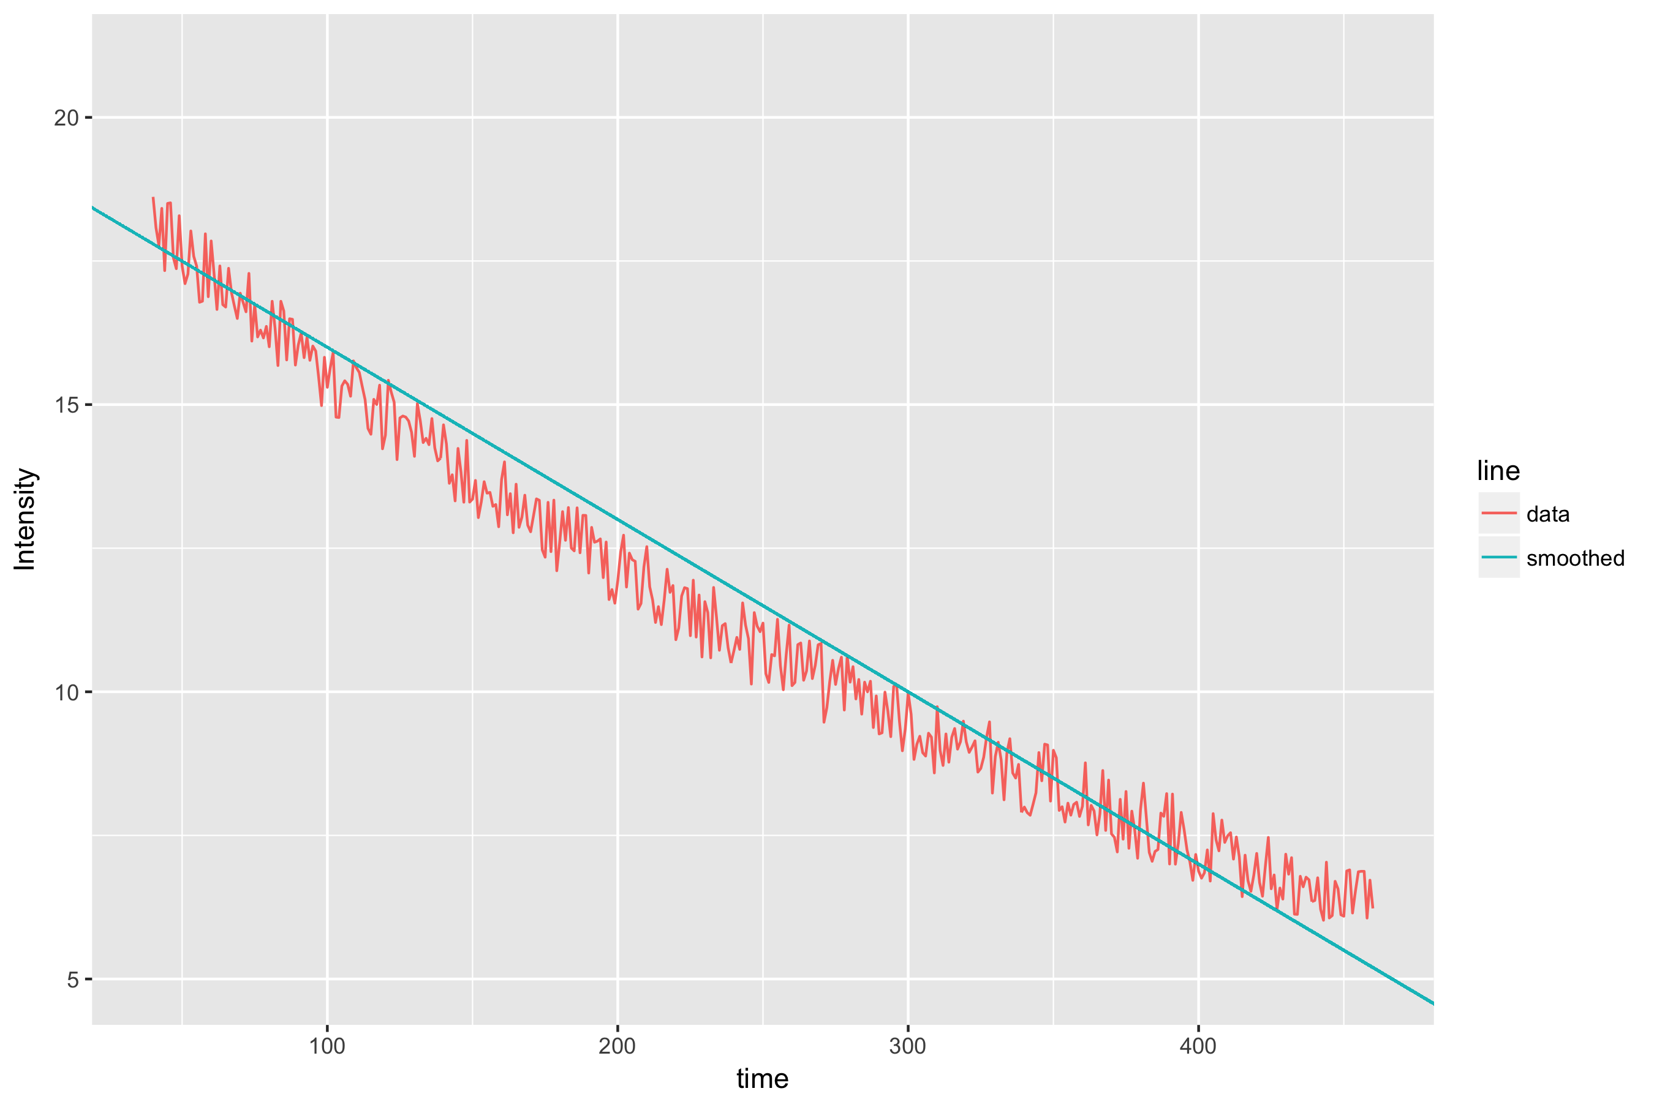
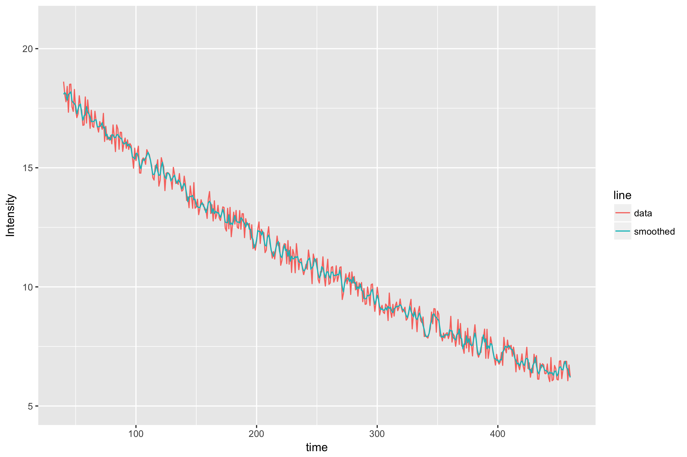

The size of the boxcar
A boxcar of size 75 ✔
A boxcar of size 3
A boxcar of size 10
A boxcar of size 1000

Slide 13
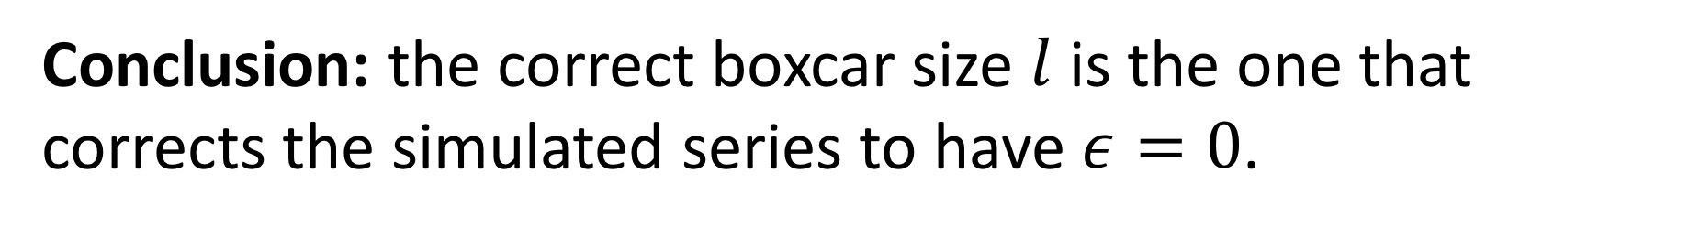
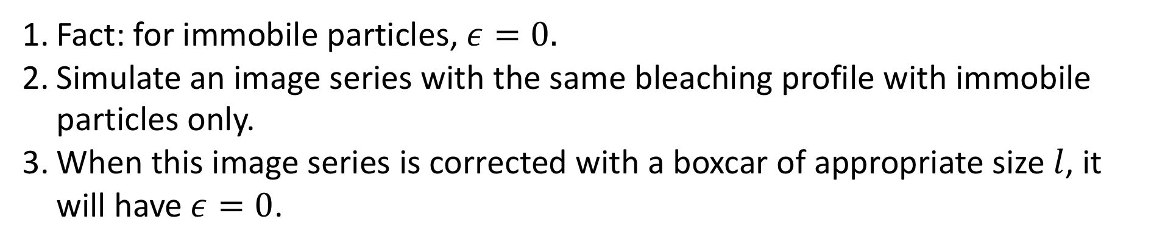
Solving for the size of the boxcar
Fact: for immobile particles, $ε=0.$
Simulate an image series with the same bleaching profile with immobile particles only.
When this image series is corrected with a boxcar of appropriate size $l$, it will have $ε=0$.
Conclusion: the correct boxcar size $l$ is the one that corrects the simulated series to have $ε=0$.
Nolan et al., 2017. nandb—number and brightness in R with a novel automatic detrending algorithm. Bioinformatics.

Slide 14
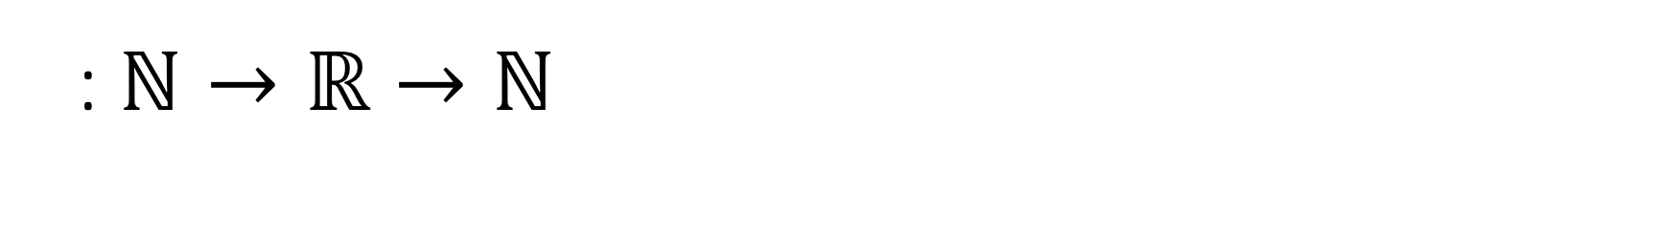
A new problem
: $ℕ→ℝ→ℕ$

Slide 15

Robin Hood
Too much intensity
(too many counts)
Too little intensity
(not enough counts)

Slide 17

https://github.com/rorynolan
https://cran.r-project.org/package=detrendr
http://rorynolan.rbind.io

Slide 18
Application: HIV-1 Receptor Stoichiometry

Slide 19
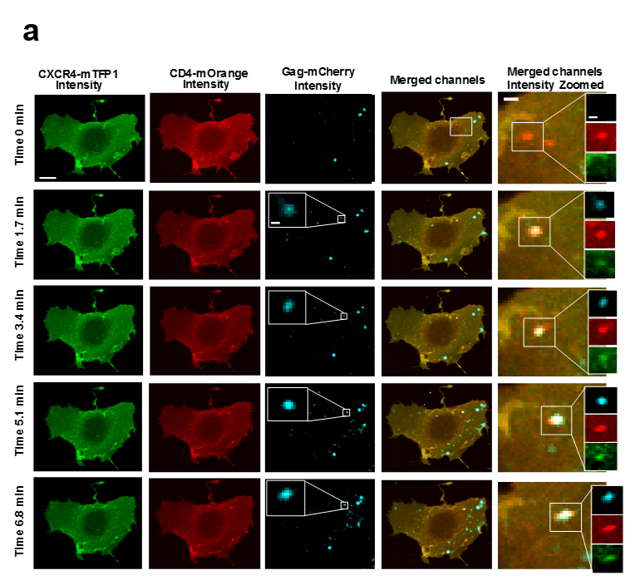

Slide 20
Kwon et al., 2015.
Nature Structural and Molecular Biology.
Step 1
Step 2
Step 3
Oligomerisation of Envelope
Chojnacki et al., 2013.
Nature Communications.
Chojnacki et al., 2012.
Science.
Khasnis et al., 2016.
PLoS Pathogens.
Notes:
1. Peter Kwong's group, NIH vaccine research centre, Maryland.
2. Christian Eggeling's group, Oxford (WIMM).
3. Michael Root's group, Philadelphia.
Put graph in here
This is the model that fits our data and these are the publications that have seen glimpses of each of our steps.
Anchoring domain and fusion domain.

Slide 21
https://github.com/rorynolan
https://cran.r-project.org/package=detrendr
http://rorynolan.rbind.io

